Slide 1
Java Phase 2
MCE

Slide 2
Day wise Topics
Day 1. Packages, Exceptions and Streams
Custom Packages, Exception Handling (try-catch, custom exceptions), Intro to Java Streams API
Day 2. Introduction to JDBC
JDBC Architecture, DB Connection, Basic SQL in Java (, SELECT, INSERT, UPDATE, DELETE)
Day 3. JDBC CRUD with MySQL
CLI based CRUD Operations using JDBC + MySQL , error handling, multi class design
Day 4. Intro to Maven, JUnit, Git
Maven Structure, Basic Unit Testing with JUnit, Git Commands (Clone, Commit, Push)
Day 5, Day 6: Guided Mini Project

Slide 3
Pre Requisites
Java 25 (Latest Version, Long Term Support)
IntelliJ IDEA (Community Edition)
MySQL (Community Edition)

Slide 4
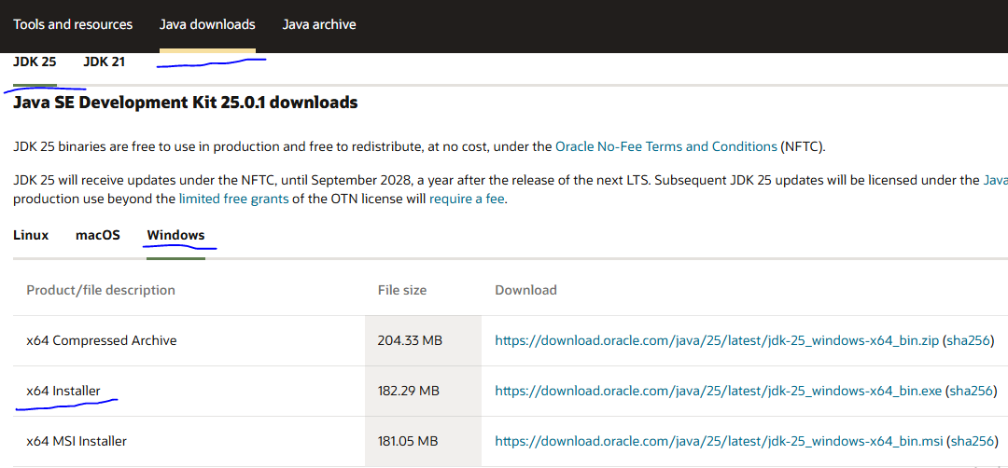
Install Java 25
https://www.oracle.com/in/java/technologies/downloads/

Slide 5
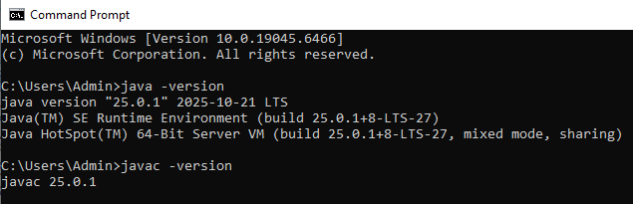
Test Java Version
Open Command Prompt

Slide 6
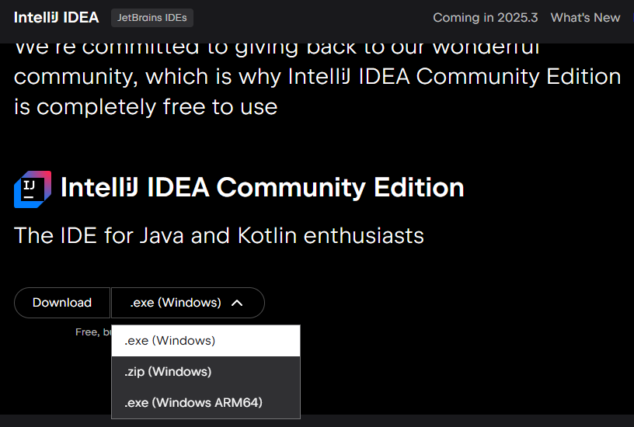
Install IntelliJ IDEA
https://www.jetbrains.com/idea/download/

Slide 7
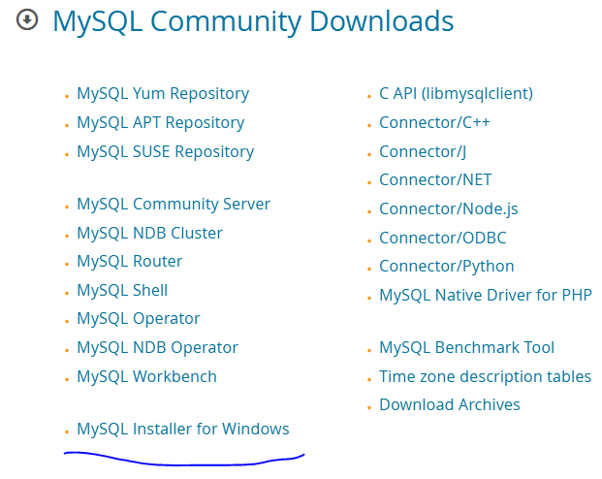
Install MySQL
https://dev.mysql.com/downloads/

Slide 8
MySQL
Open-source relational database management system (RDBMS) that utilizes Structured Query Language (SQL) for managing and manipulating data.
It is widely used for storing and organizing data in a structured format, enabling efficient retrieval and management.

Slide 9
SQL Queries (Commands)
Data Definition Language (DDL)
Commands used to define and manage the structure of database objects.
CREATE, ALTER, DROP, TRUNCATE, RENAME
Data Manipulation Language (DML)
Commands used to manage and manipulate the data within the database objects.
SELECT, INSERT, UPDATE, DELETE

Slide 10
Database and Tables
Create Schema mobile_db
Create Table mobile inside mobile_db schema.
use mobile_db;
CREATE TABLE mobile (id BIGINT PRIMARY KEY AUTO_INCREMENT,brand VARCHAR(30), model VARCHAR(50),year_launched INT, price decimal(15,2))

Slide 11
SQL CRUD Queries
INSERT
SELECT
UPDATE
DELETE
TRUNCATE
DROP

Slide 12
String Functions
CONCAT(str1, str2, ...): Concatenates two or more strings.
LENGTH(str): Returns the length of a string in bytes.
UPPER(str) / LCASE(str): Converts a string to uppercase or lowercase.
SUBSTRING(str, start, length): Extracts a substring from a string.
TRIM(str): Removes leading and trailing spaces from a string.

Slide 13
Numeric Functions
ABS(num): Returns the absolute value of a number.
ROUND(num, decimals): Rounds a number to a specified number of decimal places.
CEIL(num) / FLOOR(num): Returns the smallest integer greater than or equal to, or the largest integer less than or equal to, a number, respectively.
SQRT(num): Returns the square root of a number.

Slide 14
Date and Time Functions
NOW(): Returns the current date and time.
CURDATE(): Returns the current date.
YEAR(date) / MONTH(date) / DAY(date): Extracts the year, month, or day from a date.
DATEDIFF(date1, date2): Calculates the difference in days between two dates.

Slide 15
Aggregate Functions
COUNT(column): Counts the number of rows or non-null values in a column.
SUM(column): Calculates the sum of values in a column.
AVG(column): Calculates the average of values in a column.
MAX(column) / MIN(column): Returns the maximum or minimum value in a column.

Slide 16
Sql Queries - 1
SELECT * FROM mobile
SELECT * FROM mobile LIMIT 10
SELECT * FROM mobile LIMIT 10 OFFSET 800
SELECT * FROM mobile WHERE brand = 'Samsung' LIMIT 10 OFFSET 20
SELECT count(id) FROM mobile
SELECT count(id) FROM mobile WHERE brand = 'Samsung'

Slide 17
Sql Queries - 2
SELECT MIN(price) FROM mobile;
SELECT MIN(price) FROM mobile WHERE brand = 'Samsung‘
SELECT MAX(price) FROM mobile;
SELECT MAX(price) FROM mobile WHERE brand = 'Samsung‘
SELECT DISTINCT(brand) FROM mobile
SELECT id,UPPER(brand),model,year_launched FROM mobile;

Slide 18
Sql Queries - 3
SELECT id,brand,model,year_launched FROM mobile where brand = 'Samsung‘;
SELECT * FROM mobile where price < 10000;
SELECT * FROM mobile where price < 10000 and brand = 'Samsung‘;
SELECT * FROM mobile order by model desc;
SELECT * FROM mobile order by price;

Slide 19
Sql Queries - 4
SELECT brand, COUNT(id) AS mobile_count FROM mobile GROUP BY brand;
SELECT brand, MIN(price) AS mobile_min FROM mobile GROUP BY brand;
SELECT brand, MAX(price) AS mobile_max FROM mobile GROUP BY brand;
SELECT brand, SUM(price) AS mobile_sum FROM mobile GROUP BY brand;
SELECT brand, AVG(price) AS mobile_avg FROM mobile GROUP BY brand;
SELECT id,brand,model,year_launched,price,price - (price * 0.20) as discount_price FROM mobile;

Slide 20
Maven Repository
Third Party Library is needed to develop applications in Java.
We have to download libraries, configure, compile, handle versions and include in our project.
We have to Build the process, update the dependancy library versions, Testing and Packaging.

Slide 21
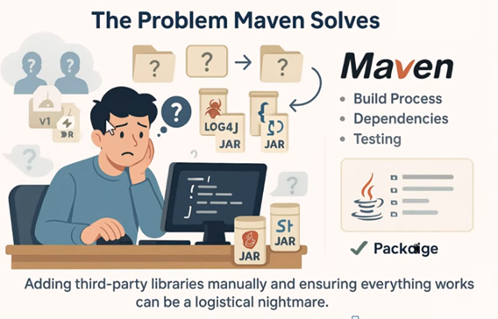
Problem Maven Solves

Slide 22
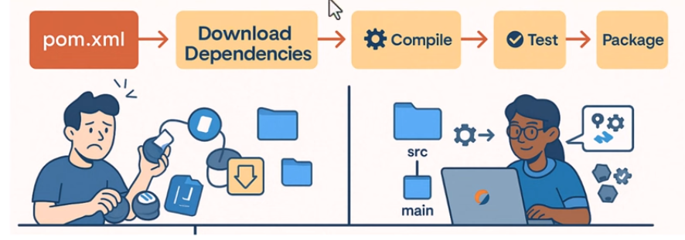
What Maven Does for you

Slide 23
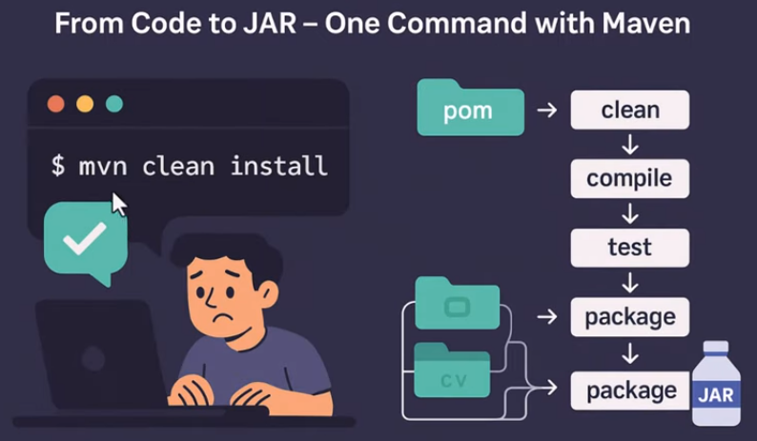
Maven Command

Slide 24
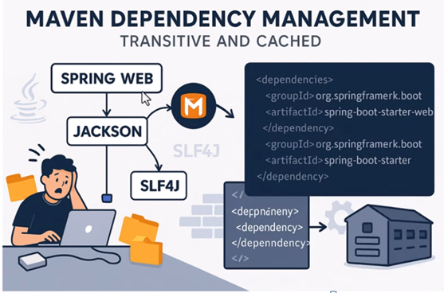
Transitive Dependency

Slide 25
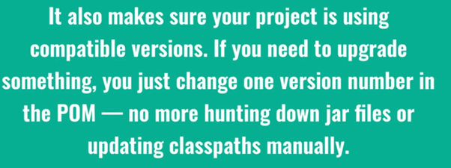
Versioning is Simple

Slide 26
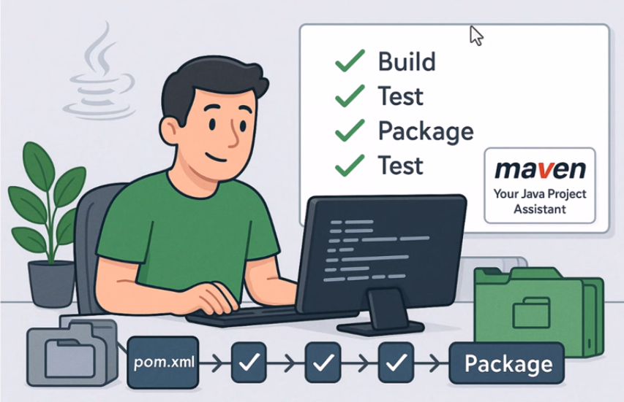
Java Project Assistant

Slide 27
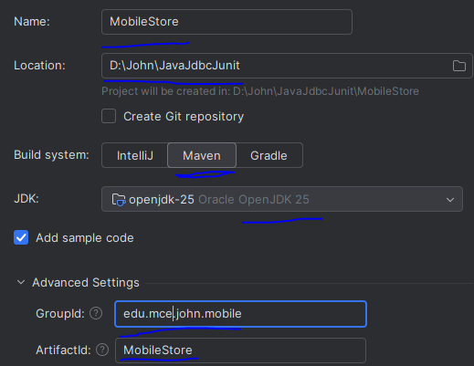
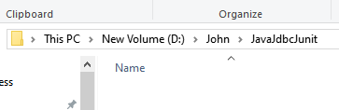
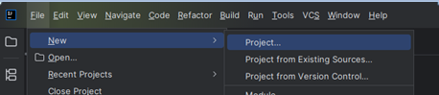
IntelliJ IDEA Project
Create Workspace Folder.
Create Project in
IntelliJ IDEA

Slide 28
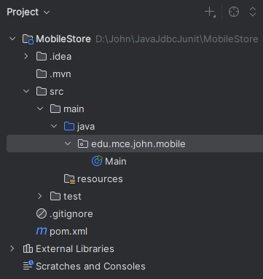
Project Structure

Slide 29
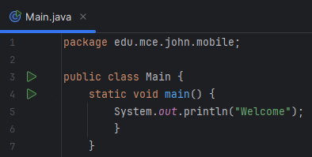
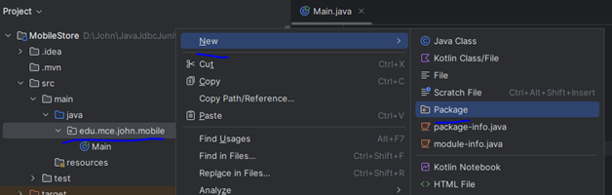
Create New Package ‘models’
Write, Compile and Run First Program

Slide 30
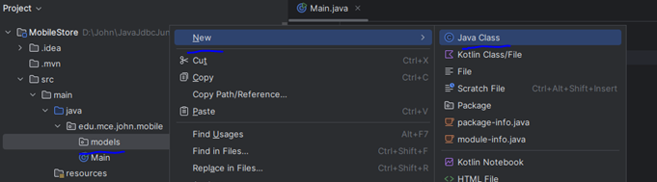
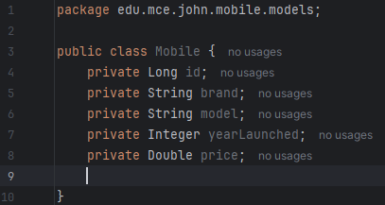
Create New Class ‘Mobile’ in models package

Slide 31
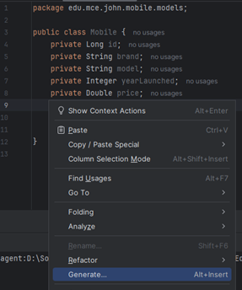
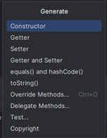
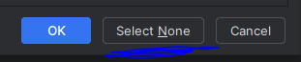
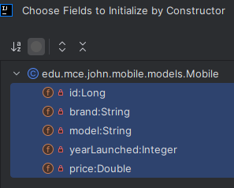
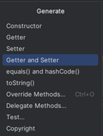
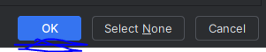
Generate Default & Parameterized Constructors, Getters & Setters and toString.

Slide 32
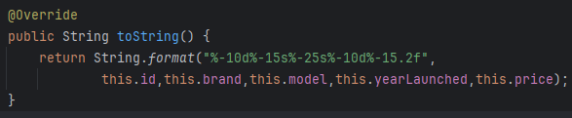
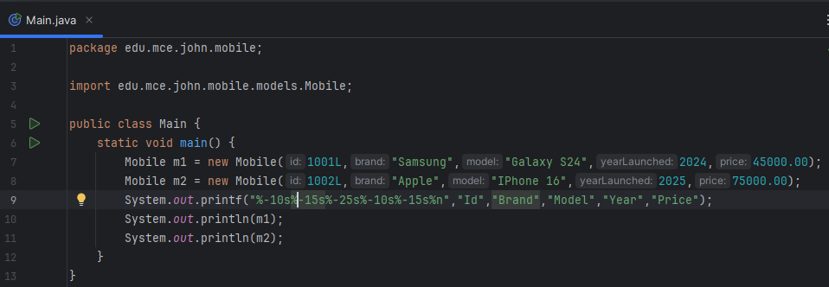
toString()
Create two mobile objects and display

Slide 33
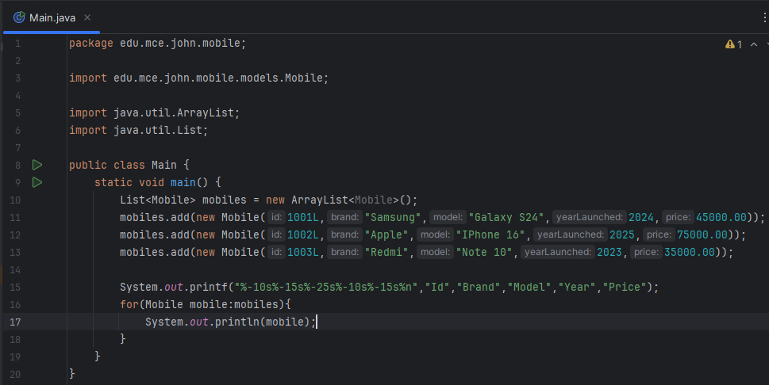
Create Mobile ArrayList and display

Slide 34
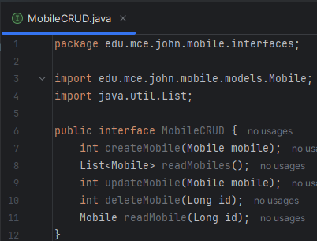
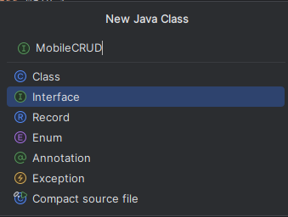
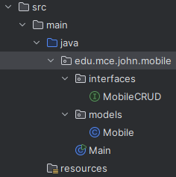
Mobile CRUD
Create new Package ‘interfaces’
Create new Interface MobileCRUD under interfaces package.

Slide 35
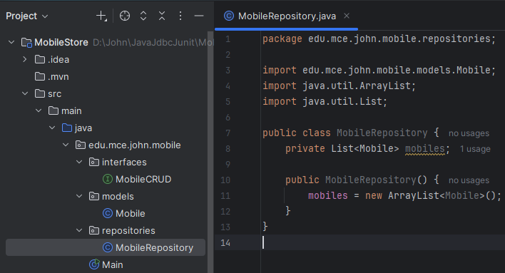
Mobile Repository
Create Package ‘repositories’.
Create Class ‘MobileRepository’ in repositories package.

Slide 36
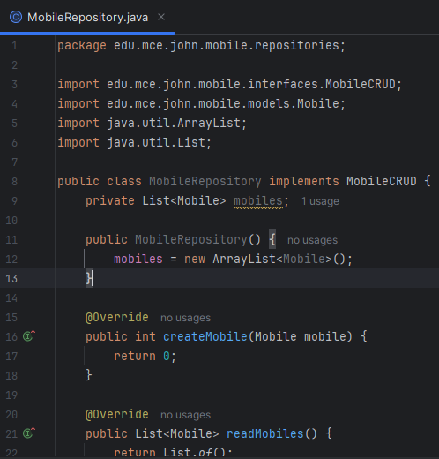
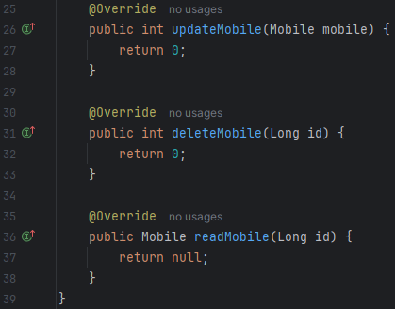
Implement MobileCRUD

Slide 37
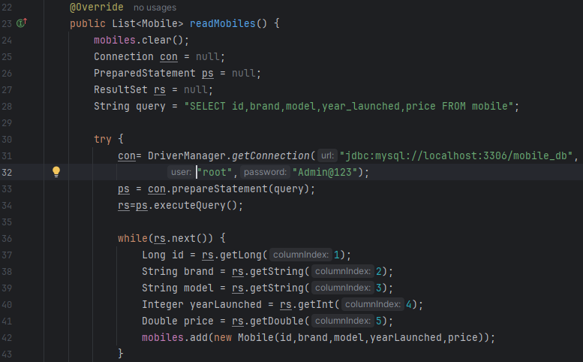
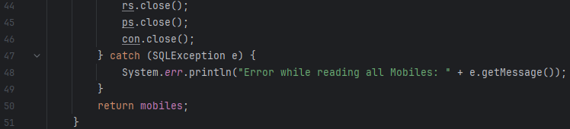
ReadMobiles (Repository)

Slide 38
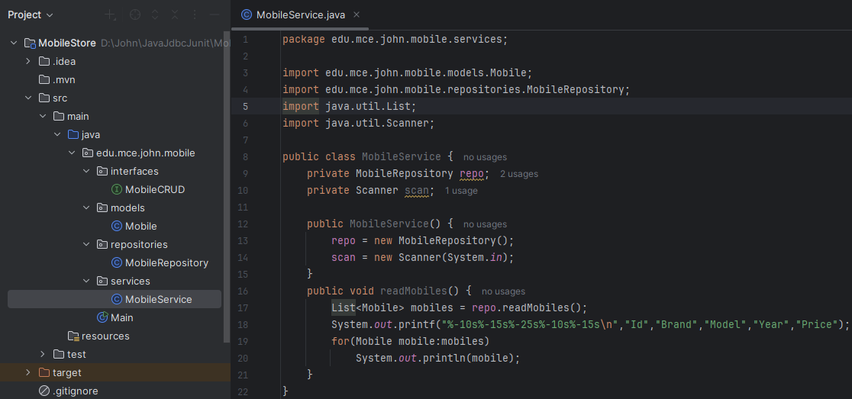
ReadMobiles (Service)
Create Interface ‘services’.
Create Class ‘MobileService’ under the package ‘services’.

Slide 39
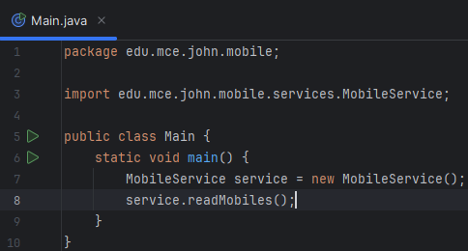
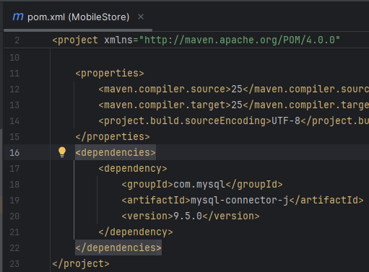
Test Read Mobiles Operation
Add mysql dependency in pom.xml

Slide 40
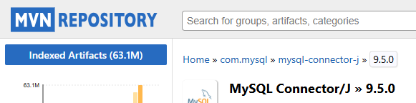
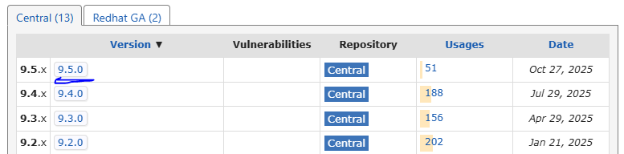
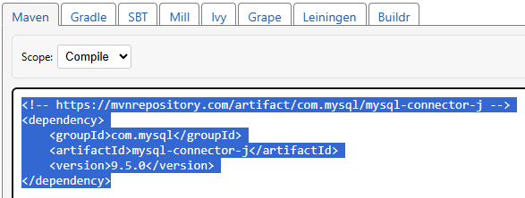
MySQL Driver from Maven

Slide 41
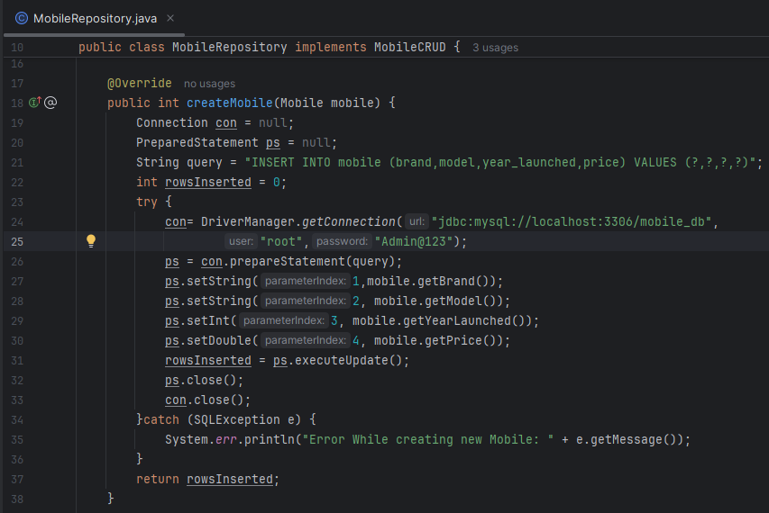
Create Mobile (Repository)

Slide 42
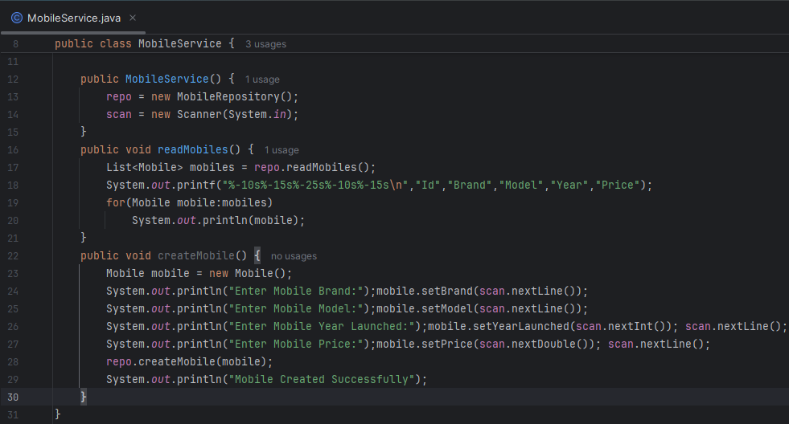
Create Mobile (Service)

Slide 43
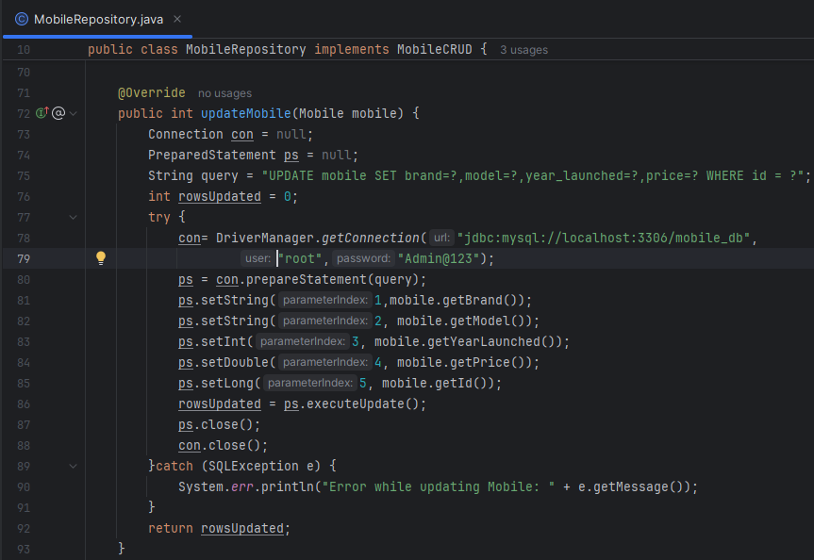
Update Mobile (Repository)

Slide 44
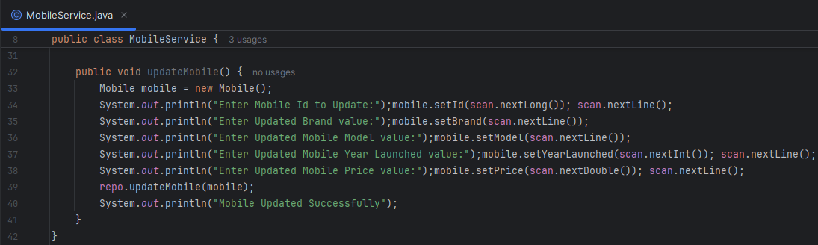
Update Mobile (Service)

Slide 45
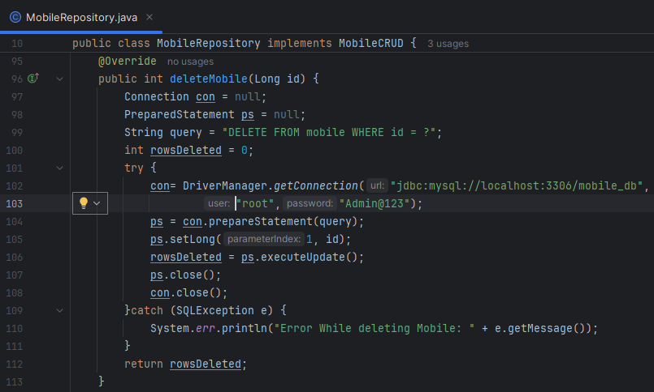
Delete Mobile (Repository)

Slide 46
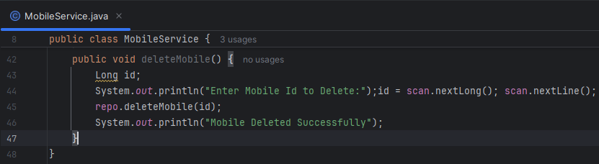
Delete Mobile (Service)

Slide 47
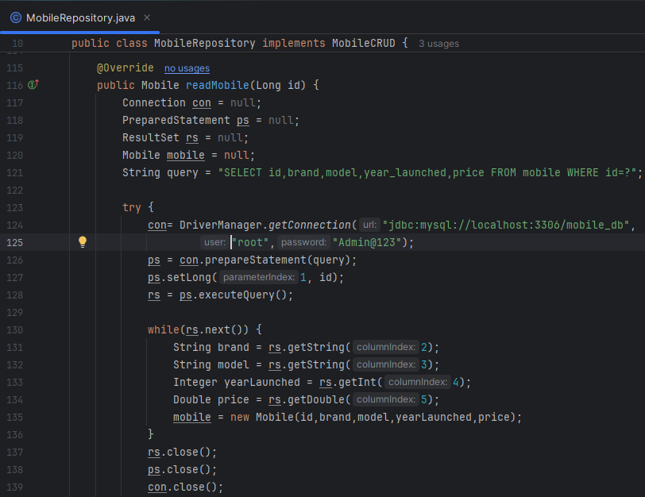
Read Mobile (Repository)

Slide 48
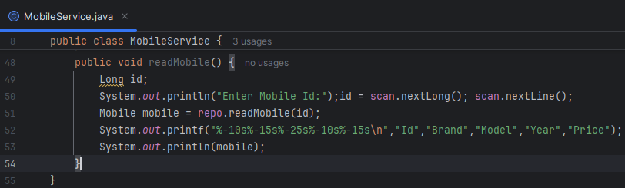
Read Mobile (Service)

Slide 49
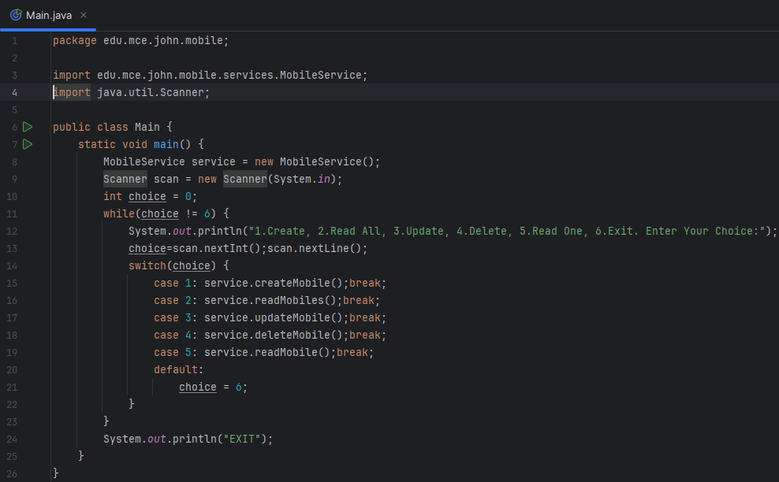
Test CRUD Menu Console

Slide 50


Slide 51


Slide 52


Slide 53
Stream Intermediate Operations
Transform a stream into another stream, allowing for chaining multiple operations together. They are lazy, meaning they are not executed until a terminal operation is invoked.
filter(Predicate<T> predicate): Returns a stream consisting of the elements that match the given predicate.
map(Function<T, R> mapper): Returns a stream consisting of the results of applying the given function to the elements of this stream.
distinct(): Returns a stream consisting of the distinct elements (according to equals()) of this stream
sorted(Comparator<T> comparator): Returns a stream consisting of the elements of this stream, sorted according to natural order or a provided Comparator.
limit(long maxSize): Returns a stream consisting of the elements of this stream, truncated to be no longer than maxSize.
skip(long n): Returns a stream consisting of the remaining elements of this stream after discarding the first n elements.

Slide 54
Stream Terminal Operations
Produce a result or a side-effect, and they consume the stream, marking the end of the stream pipeline.
forEach(Consumer<T> action): Performs an action for each element of this stream.
collect(Collector<T, A, R> collector): Performs a mutable reduction operation on the elements of this stream, using a Collector to accumulate elements into a result container (e.g., List, Set, Map)
count(): Returns the count of elements in this stream.
min(Comparator<T> comparator) / max(Comparator<T> comparator): Returns an Optional describing the minimum or maximum element of this stream according to the provided Comparator.

Slide 55



Slide 56


Slide 57


Slide 58


Slide 59


Class StreamServices in services package

Slide 60

Show All Mobiles

Slide 61



Utils Package with classes

Slide 62


Filter Mobiles by Brand

Slide 63


Filter Mobiles By Price

Slide 64


Filter Mobiles by Brand and Price
Find Mobile

Slide 65


Model and Price Sorter

Slide 66


Sort Mobiles by Price

Slide 67

Sort Mobiles by Model - 1

Slide 68

Sort Mobiles By Model - 2

Slide 69


Show Single Column All Values
Show Single Column Unique Values

Slide 70



Uppercase Column
Discount Price Column

Slide 71

Count, Min and Max for brand

Slide 72



Count of Each Brand Mobiles
Min Price of Each Brand Mobiles
Max Price of Each Brand Mobiles

Slide 73

Pagination

Slide 74


Slide 75


Slide 76


Slide 77


Slide 78


Slide 79


Slide 80


Slide 81


Slide 82


Slide 83


Slide 84




Create Mobile Repository Test

Slide 85


Create Mobile Repository Reference
testReadMobiles

Slide 86


testCreateMobile
testUpdateMobile

Slide 87


testDeleteMobile
testReadMobile

Slide 88


Before All
Run class Mobile Repository Test

Slide 89


Slide 90



Slide 91


Slide 92


Slide 93


Git Installation

Slide 94


Git Version
Create a Workspace Folder

Slide 95

Open workspace folder in IntelliJ IDEA

Slide 96


Git Config
Git Repository Initialization

Slide 97


Check the folder

Slide 98


Git Status

Slide 99

add, commit, log

Slide 100

Add all files and commit
Check git log and git status

Slide 101


Git checkout

Slide 102

Git Remote and Push
Create Account in Git Hub. Create new Repository.
Check Git Hub contents and click those 2 commits.

